Slide 1

UNICORN: AN ANOMALY BASED DETECTION FOR APT’S
BY,
VINEETH MYLAVARAPU

Slide 2
Introduction
Anomaly Based Detection for APT’s
Concept of APT’s (Advanced Persistent Threats)
Impacts of APT’s on Organizations.
Uses of Unicorn for Detections
Key Features of Unicorn
Real Life example of Unicorn Usage

Slide 3
Hypothesis
UNICORN can detect APTs more accurately than traditional signature-based detection systems.
By comparing the detection rates of UNICORN and traditional signature-based detection systems in identifying known APT’s.
Also, UNICORN can detect APTs even in highly complex and dynamic networks.

Slide 4
Theory
Our approach to host intrusion detection involves assuming APT scenarios, wherein an unauthorized individual gains access to a system and intends to stay undetected for a prolonged duration.
UNICORN aims to identify slow-moving attacks at any phase by analyzing the host's generated provenance.
Before an attack occurs, UNICORN closely monitors the host system during its regular operations, ensuring that no attacks surface during the initial modeling phase.

Slide 5
Design methods
UNICORN is a type of host-based intrusion detection system that can detect intrusions on multiple networked hosts simultaneously. Below are some methods mentioned for designing the system:
Takes as input a labeled, streaming provenance graph.
Builds at runtime an in-memory histogram.
Periodically, computes a fixed-size graph sketch.
Clusters sketches into a model.

Slide 6
What is an APT ?
APT stands for "Advanced Persistent Threat." It is a type of targeted cyber attack that involves a prolonged and stealthy intrusion into a computer network in order to steal sensitive data or cause damage to the network.
APT’s are typically carried out by skilled attackers with access to advanced tools and techniques. They can remain undetected for long periods of time, and their goal is often to exfiltrate sensitive data.
APT’s involve several phases, including reconnaissance, initial intrusion, establishing persistence, privilege escalation, and data exfiltration. Attackers use a variety of tactics, such as spear-phishing and social engineering, to achieve their goals.
Detecting and preventing APTs requires a multi-layered approach that includes network security tools, user training, and best practices for security hygiene.

Slide 7
Overview of Unicorn
UNICORN uses provenance analysis to detect APT’s where it tracks provenance data to detect anomalous behavior and identify potential APT’s.
APT’s are often designed to be low and slow, meaning that they operate quietly over a long period of time in order to avoid detection. UNICORN is specifically designed to detect these types of attacks, using provenance analysis to identify suspicious behavior that might otherwise go unnoticed.
UNICORN is highly customizable and can be tailored to the needs of specific organizations. It can be used to detect a wide range of APTs, including those that involve malware, data exfiltration, or privilege escalation.

Slide 8
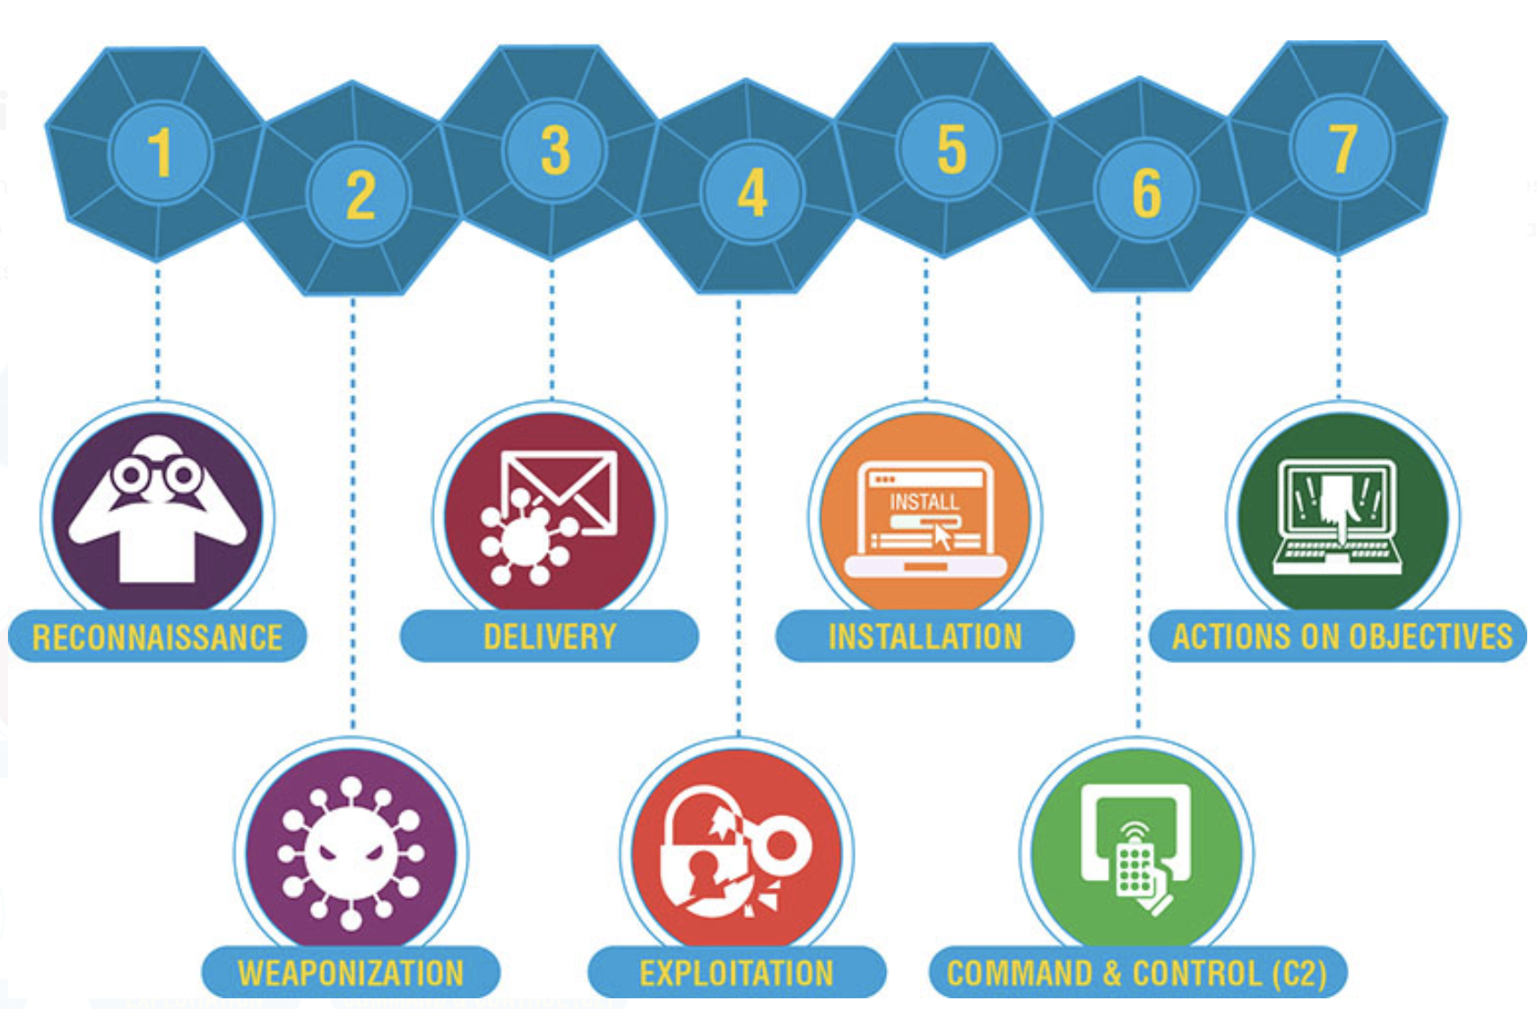
Stages of Cyber Kill Chain

Slide 9
Problem
The primary issue with APTs is their slow and protracted nature, as the attacker takes measures to avoid detection throughout the attack. This sets them apart from conventional attacks, which are typically faster and more direct in their execution.
Conventional detection systems are inadequate for identifying APTs, as they rely on matching the signatures of known malware that exploit system vulnerabilities.
APT detection systems that rely on anomaly analysis can effectively scrutinize much of the system, but they may struggle to model behavior patterns over extended periods of time. Additionally, they can be vulnerable to evasion techniques, making them somewhat less effective at identifying APT’s.
Due to the slow and gradual nature of the attack, the detection system may interpret anomalous actions as normal behavior and fail to trigger any alarms.
Systems that aim to capture long-term behavior are constrained in their ability to analyze event co-occurrence due to the potential for high computational and memory requirements.

Slide 10
Importance
UNICORN requires significant computational resources and storage capacity to operate effectively. Depending on the size and complexity of the network being monitored, this can place a heavy burden on hardware and infrastructure.
Like any intrusion detection system, UNICORN can generate false positives and false negatives. False positives can result in unnecessary alerts, while false negatives can allow threats to go undetected.
Large organizations aim to avoid falling victim to APTs, which can result in financial losses and reputational damage.

Slide 11
Examples of APT’s
APT39 is a threat group that is believed to be based in Iran and has been active since at least 2014. The group has been linked to cyber espionage and has targeted a wide range of industries, including telecommunications, healthcare, and technology.
APT41 is a Chinese-based advanced persistent threat group that has been active since at least 2012. The group is known for targeting a wide range of industries, including healthcare, technology, telecommunications, and gaming. APT41 is unique in that it is one of the few threat groups known to engage in both cyber espionage and financially motivated cybercrime.

Slide 12
Major Contributions
The paper introduces an anomaly detection system based on provenance that is specifically designed for detecting APT attacks.
Also, it introduces a new time-weighted provenance encoding method based on sketches, which is compact and can effectively summarize provenance graphs over extended periods.
UNICORN's effectiveness in detecting APTs is evaluated by the author through both simulated and real-life attack scenarios. The evaluation results demonstrate that UNICORN has a high level of accuracy in detecting APT’s.
In comparison to previously employed methods, UNICORN exhibits a significant improvement in precision and accuracy, increasing them by 24% and 30%, respectively.

Slide 13
Before & After Implementation
Existing Method
Without a dedicated APT detection system, organizations may lack visibility into APT activity on their networks. This can leave them vulnerable to sophisticated attacks that are designed to evade traditional security measures.
Traditional security measures such as firewalls and antivirus software may not be sufficient to detect APTs, which can operate undetected for extended periods.
UNICORN
UNICORN provides a centralized logging system that allows security analysts to track and analyze all incoming traffic to the network. This improves visibility into APT activity and allows for more effective detection.
UNICORN utilizes machine learning algorithms to analyze incoming traffic for signs of APT activity. This can significantly improve the accuracy and efficiency of APT detection, reducing the risk of successful attacks.
UNICORN's real-time alerts and centralized logging system enable faster incident response times, allowing organizations to take action to prevent further damage from APT attacks.

Slide 14
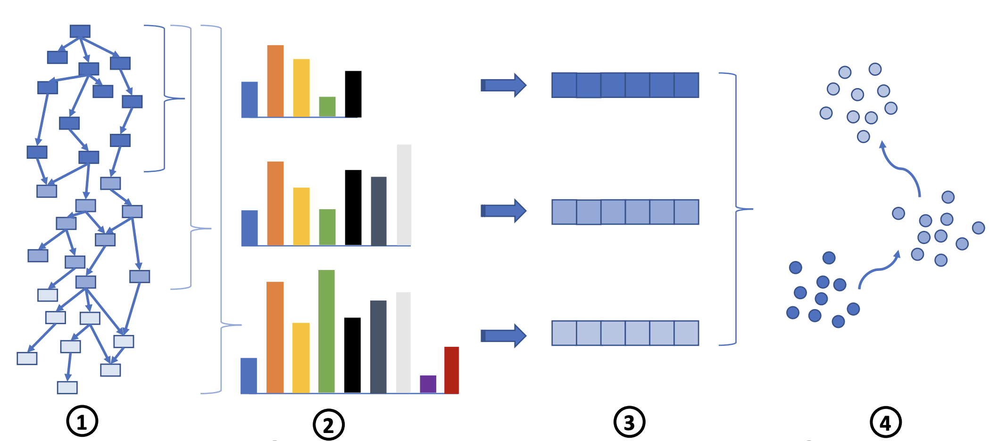
Implementation
Takes a streaming provenance graph
Periodically summarizes graph features into histograms.
Creates fixed-size graph sketches. The resulting clustering-based model.
Captures the dynamics of system execution

Slide 15
Implementation (Cont. …)
The analysis of entire system provenance graphs, regardless of memory limitations, is carried out using GraphChi, a large-scale graph computation engine that employs advanced algorithms for data mining, graph mining, and machine learning.
UNICORN employs a vertex-centric method for graph processing, implemented in C++ using GraphChi. Other components of the UNICORN system, such as modeling and data parsing, are developed in Python.
UNICORN utilizes evolutionary modeling to learn the behavior of a system at multiple time points within a single training instance.

Slide 16
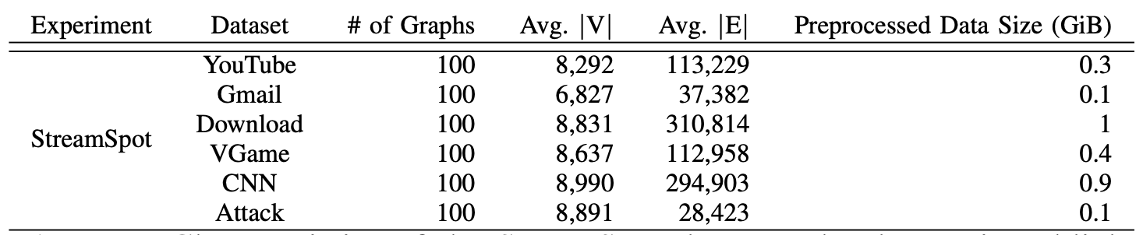
Authors Evaluation and Results
To evaluate its efficacy, UNICORN was tested on various datasets obtained from multiple sources, including StreamSpot, DARPA's TC dataset, and a simulated supply-chain attack dataset.
StreamSpot: StreamSpot generates a static model based on snapshots and dynamically updates the model during runtime.

Slide 17
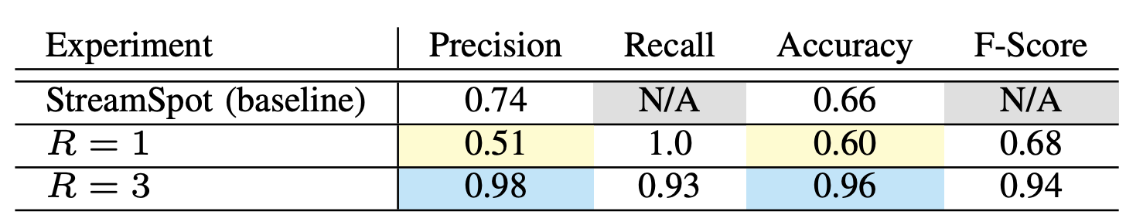
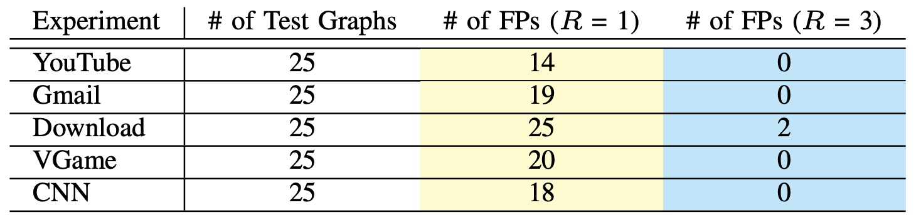
The results indicate that UNICORN outperforms StreamSpot in terms of both precision and recall when presented with a higher neighborhood exploration parameter (R).

Slide 18
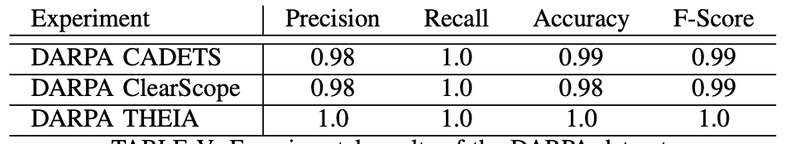
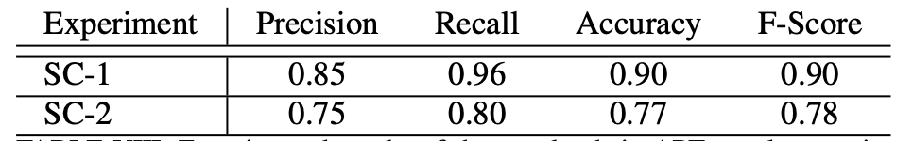
DARPA’s TC dataset:
DARPA's datasets were gathered from a network of hosts utilizing various audit systems, with the red team generating benign background activity to model typical system behavior.
The results demonstrate that UNICORN achieves high levels of precision and recall.
Simulated Supply-chain:
Two simulated scenarios of APT supply-chain attacks were conducted on a Continuous Integration (CI) platform, with each experiment running for three days.
The results demonstrate that UNICORN achieved high levels of precision and recall.

Slide 19
Evaluation
The authors analyzed around 1.5 TB of system monitoring data, which comprised roughly 2 billion OS-level provenance records.
Their findings demonstrate that UNICORN can effectively identify anomalies in real APT scenarios, while remaining highly performant and memory-efficient due to a constant cluster size.
They also showcased the ability of UNICORN to detect APT attacks using evolutionary modeling and highlighted that contextualized graph exploration improved the system's detection capabilities by enhancing its understanding of system behavior.

Slide 20
Limitations
The authors operate under the assumption that system administrators can safely execute the model to capture typical system behavior.
They also posit that a finite number of system behavior patterns exist, and that most of these patterns are observed during the modeling process.
Any new behavior may trigger a false alarm, requiring human intervention.
However, it should be noted that the testing was conducted using a limited number of datasets and focused solely on APT detection.
Further improvement can be achieved by testing with extensive datasets and expanding the system's threat detection capabilities, which would have broader implications.

Slide 21
Trend
UNICORN is a provenance-based anomaly detection system that is tailored to detecting APT attacks.
The system utilizes a vertex-centric approach to process whole-system provenance graphs using GraphChi and implements modeling and data parsing in Python.
The authors evaluated UNICORN against simulated and real-life APT attack scenarios and found that it improves the precision and accuracy of detecting APTs by a significant margin.
The paper also highlights that the trend in cybersecurity is shifting towards more intelligent and proactive techniques for threat detection, which utilize advanced methods such as provenance-based analysis.
The authors argue that it is crucial to develop and implement new detection methods to keep up with the growing sophistication of cyberattacks.

Slide 22
Conclusion
In conclusion, APTs are a significant threat to organizations, and traditional security measures are not enough to detect and prevent them.
UNICORN offers a solution to this problem by using anomaly-based detection to identify APTs in real-time. Its machine learning algorithms and threat intelligence integration make it an effective tool for identifying and preventing APT’s.
Overall, UNICORN's success in detecting APTs highlights the importance of utilizing advanced techniques in threat detection to stay ahead of potential threats.

Slide 23
Future Implementations
Anomaly Detection: SIEM can detect unusual activities such as abnormal login attempts, unusual network traffic, and unusual system activities. An APT often exhibits unusual patterns of behavior, and the SIEM system can alert the security team if it detects any anomalies.
Correlation Analysis: SIEM can correlate multiple events and detect patterns that might indicate an APT attack. For example, if there is an unusual pattern of data transfer from an internal system to an external system, and at the same time, there are unusual login attempts to that internal system, this may be a sign of an APT.
Command and Control (C2) Communications: APTs use C2 channels to communicate with their command center. SIEM can detect unusual network traffic patterns that may indicate the presence of C2 communications, such as outbound traffic to known C2 IP addresses or domains.

Slide 24
References
UNICORN: Runtime Provenance-Based Detector for Advanced Persistent Threats:
https://www.ndss-symposium.org/wp-content/uploads/2020/02/24046.pdf
GitHub repository for UNICORN: https://github.com/UNICORN-Project/UNICORN
Advanced Persistent Threats (APTs): What They Are and How to Defend Against Them: https://www.cisco.com/c/en/us/products/security/advanced-persistent-threats.html
Advanced Persistent Threat (APT) Protection: https://www.mcafee.com/enterprise/en-us/threat-center/threat-landscape-dashboard/advanced-persistent-threats.html
"Detecting Advanced Persistent Threats with Security Information and Event Management" by LogRhythm. This whitepaper provides an overview of how SIEM can be used to detect APTs and includes several use cases:
https://logrhythm.com/use-cases/detect-advanced-threats-apts/

